Slide 1
Uni-Bite App Design
By: Khansaa Shehab
Uni-Bite is a simple food app that helps university students order meals from their campus cafeteria easily and quickly.

Slide 2
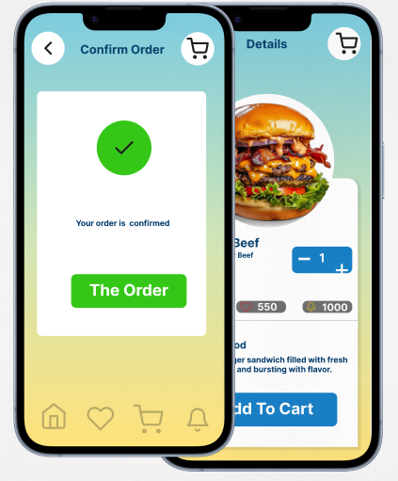
Project overview
The product:
Uni-Bite is a food-ordering app made for university students.
It connects students directly with their university cafeteria so they can see the menu, order food, and pick it up without waiting in line.
Project duration:
October 19 – October 20, 2025 (2 days)

Slide 3
Project overview
The problem:
.
The goal:
Students are often busy between classes and find it hard to wait in cafeteria lines to buy food.
Create an easy app that lets students order their meals from the university cafeteria and pick them up fast.

Slide 4
Project overview
My role:
Responsibilities:
UX/UI Designer
User research, wireframing, prototyping, testing, and improving the design.

Slide 5
User research
Personas
Problem statements
User journey maps
Understanding
the user

Slide 6
User research: summary
The main users are university students who eat at the campus cafeteria.
They want to order food quickly between classes without standing in long lines.

Slide 7
User research: pain points
1
2
3
Pain point
Pain point
Pain point
Long waiting time at the cafeteria.
No simple way to order food in advance.
Hard to track if the order is ready

Slide 8
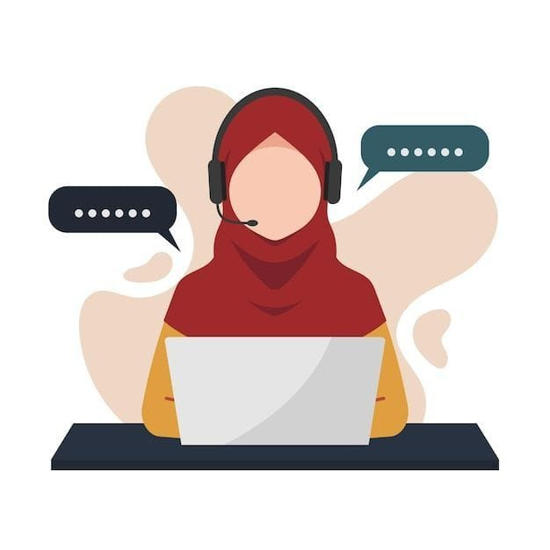
💬 Quote:
“I love getting food from the cafeteria, but I don’t like waiting in line when I have classes.”
Persona:Sara
Problem statement:
Sara is a busy university student who needs a fast and simple way to order food from her campus cafeteria because she doesn’t have time to wait in line between classes.
🎯 Goals:
To order food quickly from the cafeteria.
To pick up her meal on time between classes.
To have a simple app that saves her time.
🔥Frustrations:
Long lines during lunch hours.
Not knowing when the food is ready.No easy way to order in advance.
📌 Problem statement:
Sara is a busy university student who needs a fast and simple way to order food from her campus cafeteria because she doesn’t have time to wait in line between classes.
About Sara:
Age: 21
Education: University student
Occupation: Computer Science student
Location: On-campus housing

Slide 9
User journey map
Persona: Sara
Goal:
To Order food quickly and pick up from the university cafeteria without waiting
Stage | Action | Task List | Feeling / Adjective | Improvemen Opportunities
Open app | Sara opens the Uni-Bite app | Reads short intro and "Order Now" | Curios, interested | Make intro simple and fast
Sing up | Creates account with email | Fills name and password | Focused | Add"Remember Me"option
Browse mnu | Looks through cafteria meals | Checks prices and picures | Exclted, hungry | Use clear food categories
Place order | Chooses a meal and adds to cart | Confirms and picures | Happy, ready to eat | Add clear "Edit Order"button
Confirm & pick up | Sees success message and goes to cafrteria | Shows phone screen to collect food | Satisfied, relaxed | Add pickup time notification

Slide 10
Paper wireframes
Digital wireframes
Low-fidelity prototype
Usability studies
Starting
the design

Slide 11
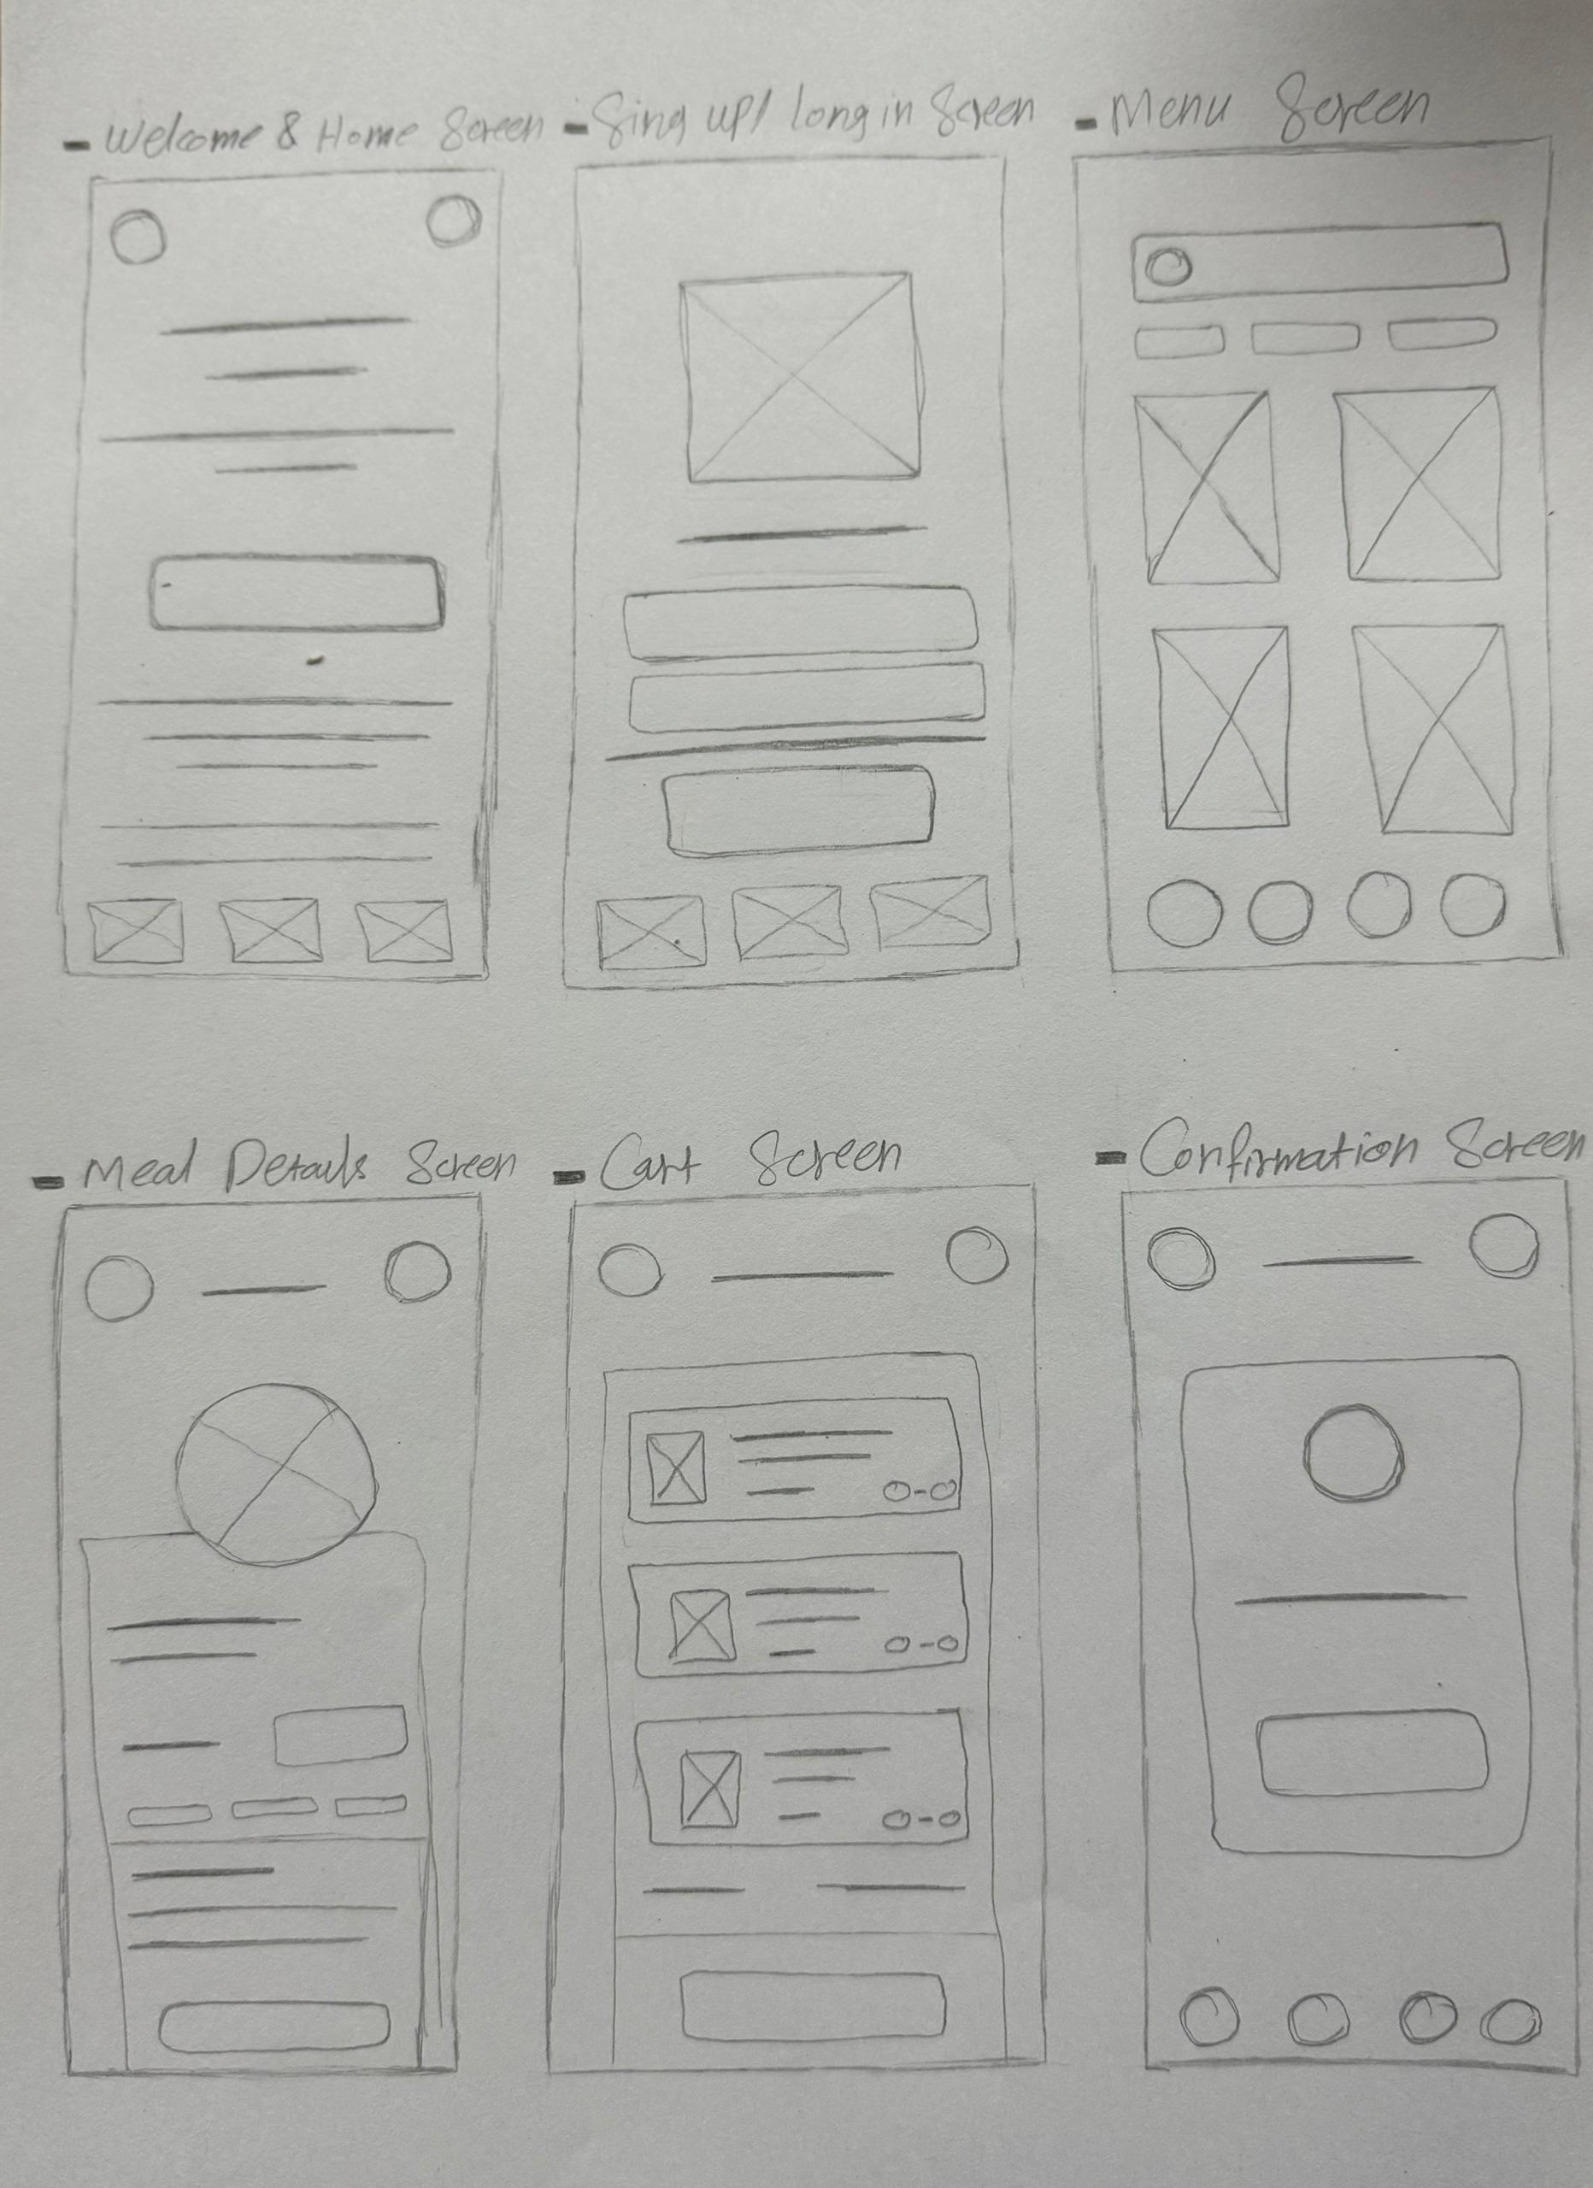
Paper wireframes
I started by drawing six main screens for the app.
The first screen shows a short introduction about Uni-Bite and the home page.
The second screen is the sign-up page.
Then comes the menu page, where students can see all available meals.
When a student clicks on a meal, a new screen shows the meal details and price.

Slide 12
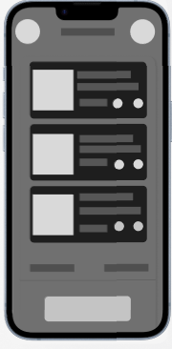
Digital wireframes
On the Cart Screen, the student can see all the items they added to their order. Each item shows the name, price, and quantity. There are small “+” and “–” buttons to increase or decrease the quantity. At the bottom, there is a clear “Confirm Order” button. When the student clicks it, they move to the confirmation screen.
Shows the full cost of all items
Click to finish your order and go to confirmation page

Slide 13
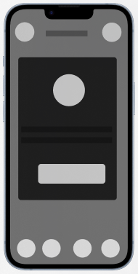
Digital wireframes
After the student confirms the order, this screen appears.
It shows a big green check mark and a message saying “Your order is confirmed!”
There is also a button labeled “Back to Home” so the student can return to the main page.
This makes the experience feel complete and easy to understand.
Green Check Mark:
"Order completed successfully"
Success Message:
Says:
"Your order is confirmed"

Slide 14
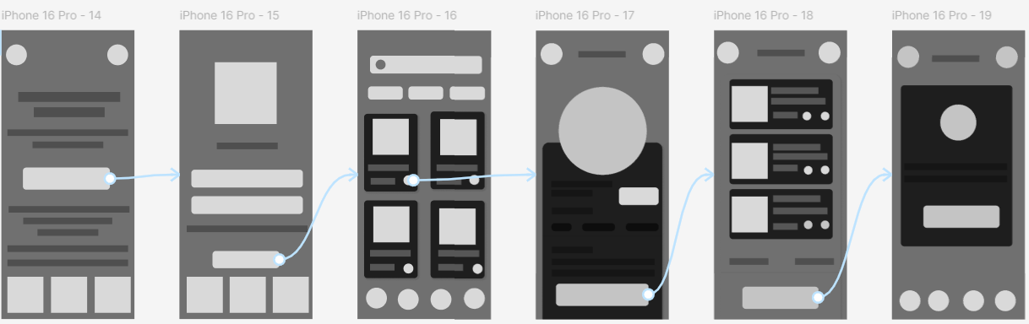
Low-fidelity prototype
The prototype connects all six screens.
Students can move from the home page to ordering and confirming their food easily.
You can click the link to view the full prototype and try the interactions.
“Full prototype created in Figma”

Slide 15
Usability study: findings
Round 1 findings
Round 2 findings
1
Students wanted faster order confirmation.
1
Added a clear success message after confirming an order.
Some users couldn’t see the total price clearly.
Improved the cart screen to show each item’s price and total.
2
2

Slide 16
Refining
the design
Mockups
High-fidelity prototype
Accessibility

Slide 17
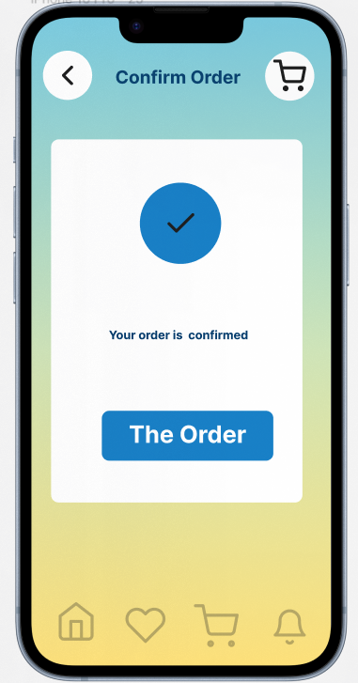
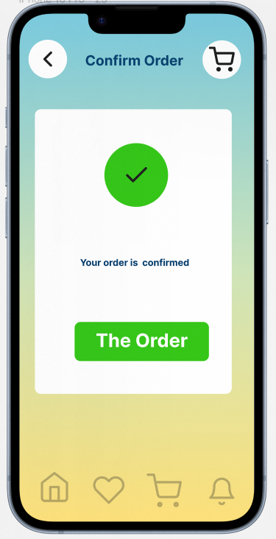
Mockups
Before usability study
After usability study
After the usability study, I made some small changes to make the app easier to use.
I focused on making the buttons clearer, improving the order confirmation message, and using friendly colors.
Before testing, the confirmation screen had a blue button and a simple layout. Some users said they didn’t notice the confirmation clearly.
After testing, I changed the button color to green and added a big success check mark. This made it clear that the order was completed successfully.

Slide 18
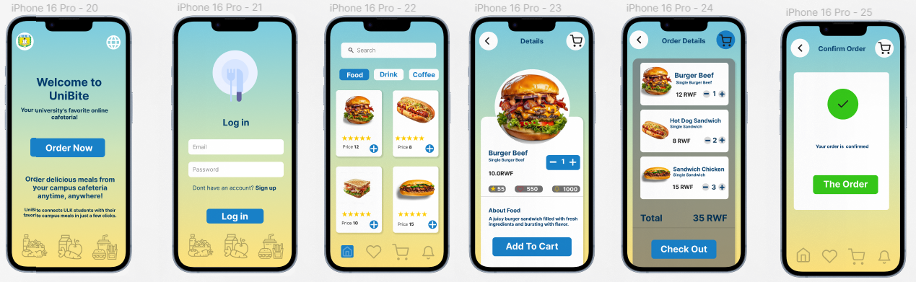
Mockups

Slide 19
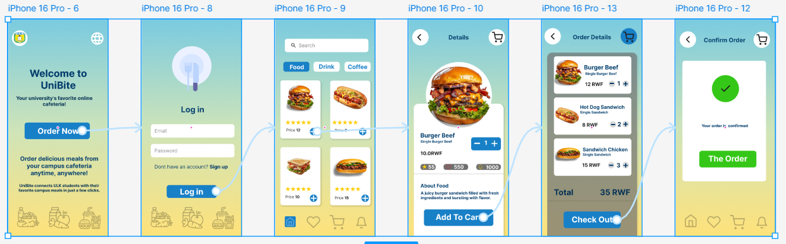
High-fidelity prototype
Here, you can see the final design of Uni-Bite. It’s simple, colorful, and easy to use for students who want to order food from their campus cafeteria
You can click the link to view the full prototype and try the interactions.
“Full prototype created in Figma”

Slide 20
Accessibility considerations
1
2
3
Used large, readable text.
Added icons for easier navigation.
Designed for one-hand use.

Slide 21
Going forward
Takeaways
Next steps

Slide 22
Takeaways
Impact:
Uni-Bite helps students save time and avoid cafeteria lines.
“It’s simple and fast! I can order food even during short breaks.”
What I learned:
I learned that simple design and clear steps make a big difference for busy students.

Slide 23
Next steps
1
2
3
Add notifications when the meal is ready.
Add an option to schedule orders.
Test the app with more students.

Slide 24
Thank you!

